Slide 1

A Closer Look at Methods and Classes Part 1 Java - The Complete Reference Herbert Schildt Chapter 7

Slide 2
Outline
Overloading Methods
Overloading Constructors
Using Objects as Parameters
A Closer Look at Argument Passing
Returning Objects
Recursion
Introducing Access Control

Slide 3
Overloading Methods

Slide 4
Overloading Methods
In Java, it is possible to define two or more methods within the same class that share the same name, as long as their parameter declarations are different.
When this is the case, the methods are said to be overloaded, and the process is referred to as method overloading.
Method overloading is one of the ways that Java supports polymorphism.
When an overloaded method is invoked, Java uses the type and/or number of arguments as its guide to determine which version of the overloaded method to actually call.
Overloaded methods must differ in the (1) data type and/or (2) number of their parameters.
While overloaded methods may have different return types, the return type alone is insufficient to distinguish two versions of a method.

Slide 5
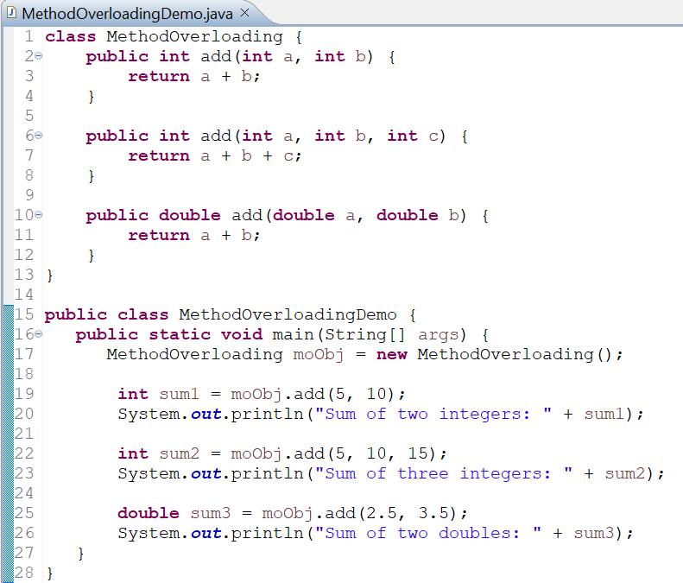
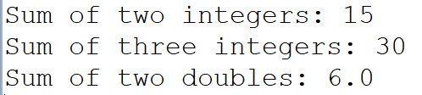
Overloading Methods: Example
OUTPUT

Slide 6
Type Conversion in Overloading Methods
When an overloaded method is called, Java looks for a match between the arguments used to call the method and the method’s parameters.
However, this match need not always be exact.
In some cases, Java’s automatic type conversions can play a role in overload resolution.

Slide 7
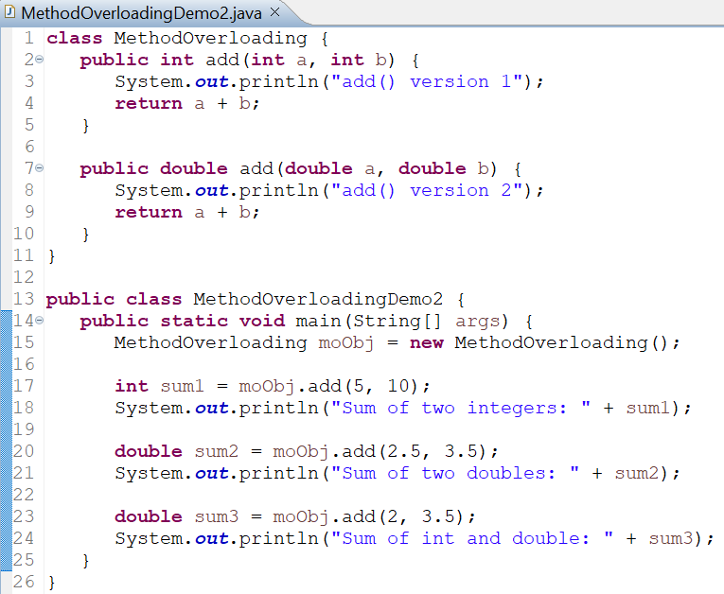
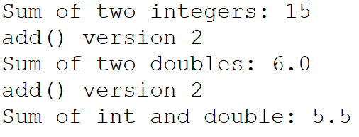
Type Conversion in Overloading Methods: Example
OUTPUT
For the last call to add() method, no exact match is found.
So, Java automatically converts int value 2 to double and calls add(double, double) version.
Java will employ its automatic type conversions only if no exact match is found.

Slide 8
Usefulness of Method Overloading
Method overloading supports polymorphism because it is one way that Java implements the one interface, multiple methods paradigm.
Example: In C, the function abs() returns the absolute value of an integer, labs() returns the absolute value of a long integer, and fabs() returns the absolute value of a floating-point value.
Since C does not support overloading, each function has its own name, even though all three functions do essentially the same thing.
In Java, the standard class library includes an absolute value method, called abs().
This method is overloaded by Java’s Math class to handle all numeric types.
Java determines which version of abs()to call based upon the type of argument.
Math Class Java Doc
https://docs.oracle.com/javase/8/docs/api/java/lang/Math.html
In practice, we should only overload closely related operations.

Slide 9
Overloading Constructors

Slide 10
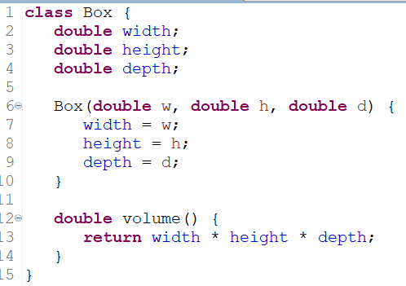
Overloading Constructors
The concept of overloading is very useful and common for constructors.
Example: If a Box class is defined as below, all declarations of Box objects must pass three arguments to the Box( ) constructor.
So, the following statement will generate compilation error:
Box ob = new Box();
What if we simply want a box and do not care (or know) what its initial dimensions were?
What if we want to be able to initialize a cube by specifying only one value that would be used for all three dimensions?

Slide 11
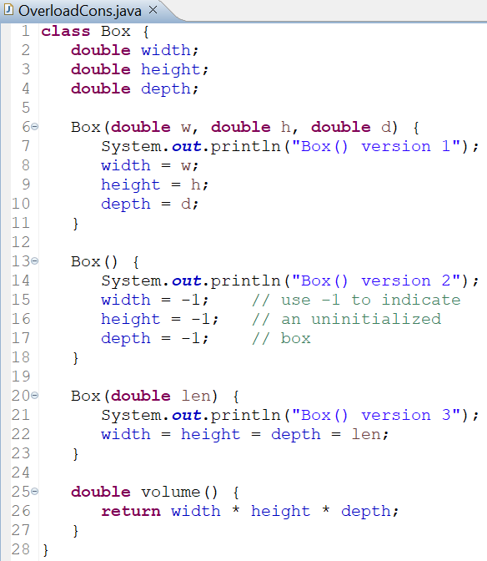
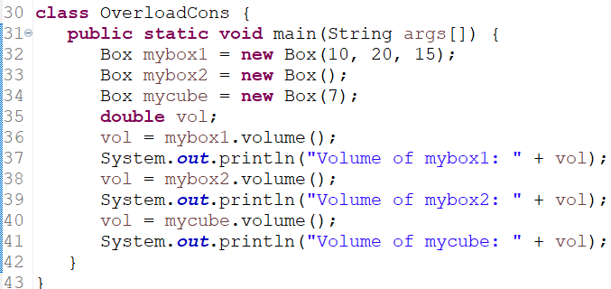
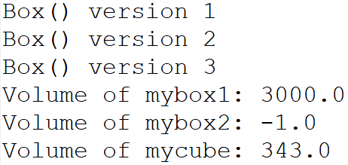
Overloading Constructors: Example
OUTPUT

Slide 12
Using Objects as Parameters

Slide 13
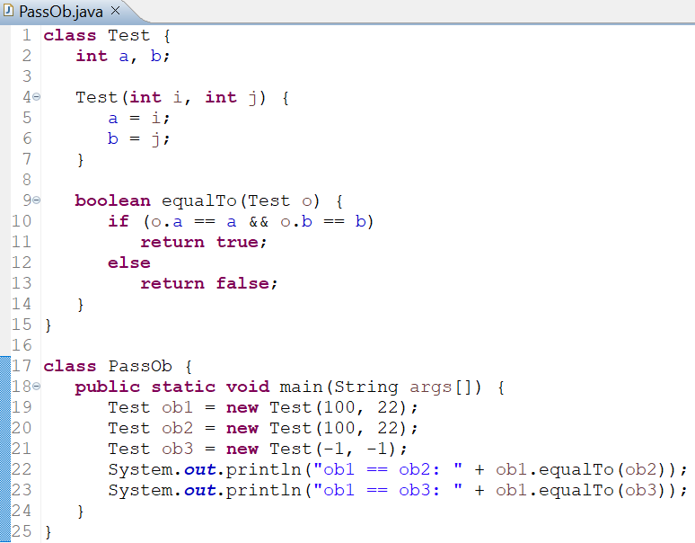

Using Objects as Parameters
Similar to basic data types, objects can be passed to methods as parameters.
OUTPUT
The equalTo() method compares the invoking object with the one that it is passed.

Slide 14
Passing Objects to Constructors
One of the most common uses of object parameters involves constructors.
Many a times we want to construct a new object so that it is initially the same as some existing object.
To do this, we must define a constructor that takes an object of its class as a parameter.

Slide 15
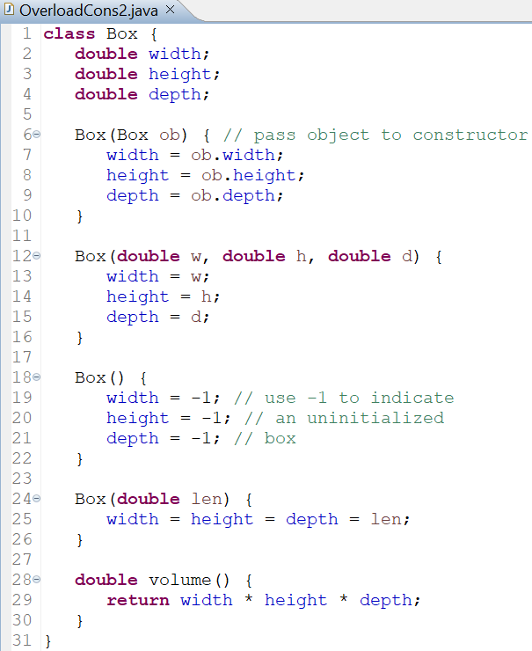
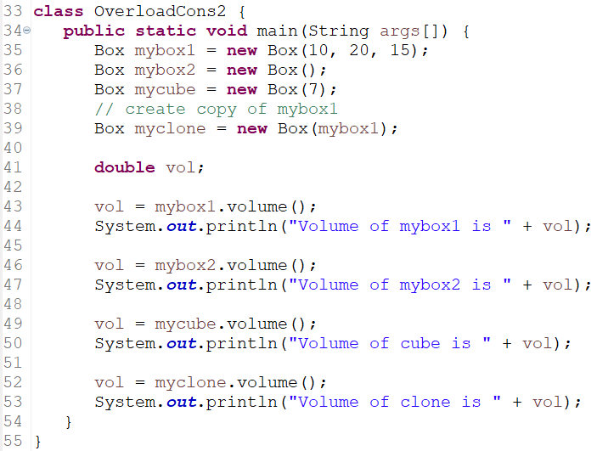
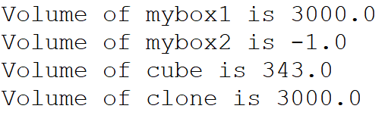
Passing Objects to Constructors: Example
OUTPUT

Slide 16
A Closer Look at Argument Passing

Slide 17
A Closer Look at Argument Passing
There are two ways of argument passing:
Call-by-value
Call-by-reference
Call-by-value
Copies the value of an argument into the formal parameter of the method.
So, changes made to the parameter of the method have no effect on the argument.
Call-by-reference
A reference to an argument (not the value of the argument) is passed to the parameter.
Inside the method, this reference is used to access the actual argument specified in the call.
So, changes made to the parameter will affect the argument used to call the method.

Slide 18
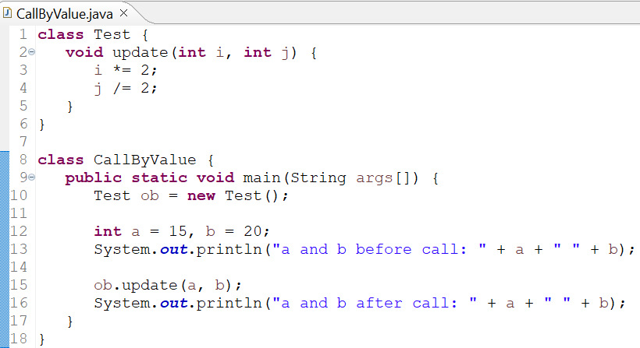

Call-by-value: Example
OUTPUT

Slide 19
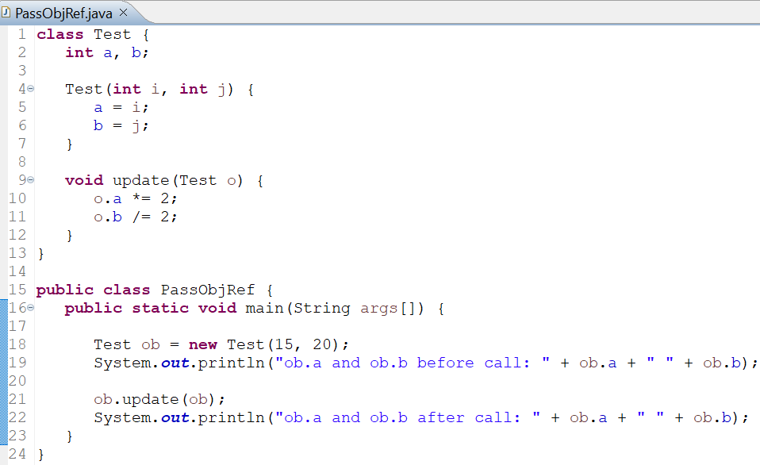

Call-by-reference: Example
When we pass an object reference to a method, the parameter that receives it will refer to the same object as that referred to by the argument.
Changes to the object inside the method do affect the object used as an argument.
OUTPUT

Slide 20
Returning Objects

Slide 21
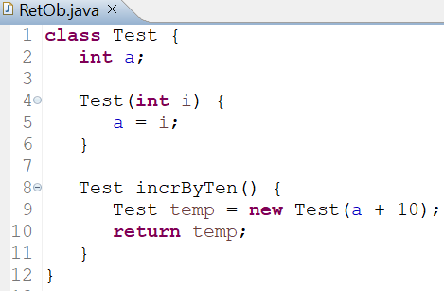
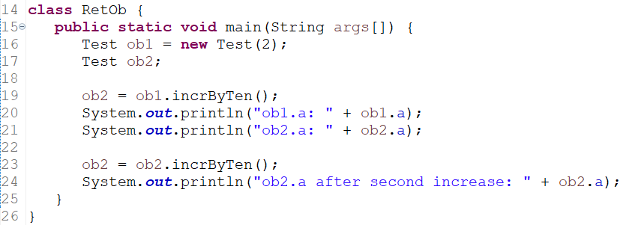
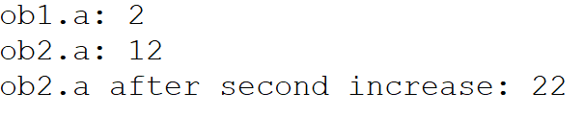
Returning Objects
A method can return any type of data, including class types that we create.
Example, in the following program, the incrByTen() method returns an object in which the value of a is ten greater than it is in the invoking object.
OUTPUT

Slide 22
Returning Objects
Each time incrByTen() is invoked, a new object is created, and a reference to it is returned to the calling routine.
Another point: Since all objects are dynamically allocated using new, we don’t need to worry about an object going out of scope because the method in which it was created terminates.
The object will continue to exist as long as there is a reference to it somewhere in your program.
When there are no references to it, the object will be reclaimed the next time garbage collection takes place.

Slide 23
Recursion

Slide 24
Recursion
Java supports recursion.
Recursion is the process of defining something in terms of itself.
In programming, recursion is the attribute that allows a method or function to call itself.
A method that calls itself is said to be recursive.
Example
Computation of the factorial of a number.
The factorial of a number N is the product of all the whole numbers between 1 and N.
3 factorial (3!) is 1 × 2 × 3, or 6.

Slide 25
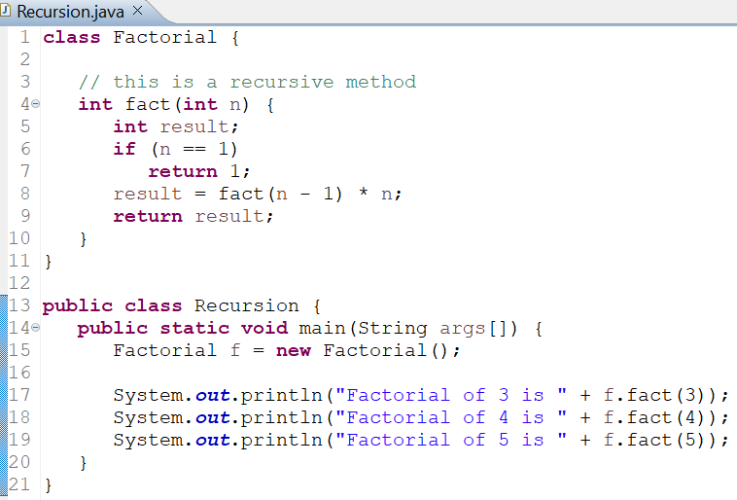
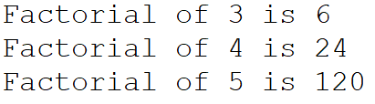
Recursion: Factorial Computation
OUTPUT

Slide 26
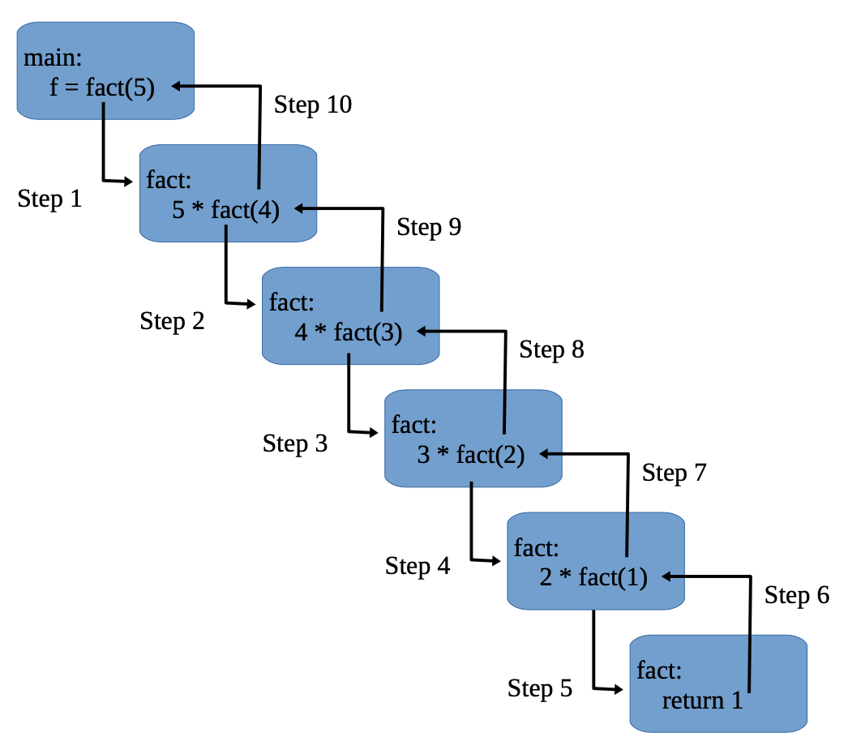
Recursion: Factorial Computation
When fact( ) is called with an argument of 1, the function returns 1; otherwise, it returns the product of fact(n–1)*n.
To evaluate this expression, fact( ) is called with n–1.
This process repeats until n equals 1 and the calls to the method begin returning.

Slide 27
Recursion: Analysis
When a method calls itself, new local variables and parameters are allocated storage on the stack, and the method code is executed with these new variables from the start.
As each recursive call returns, the old local variables and parameters are removed from the stack, and execution resumes at the point of the call inside the method.
Disadvantage of Recursion
Recursive versions of many routines may execute a bit more slowly than the iterative equivalent because of the added overhead of the additional method calls.
Many recursive calls to a method could cause a stack overrun.
Because storage for parameters and local variables is on the stack and each new call creates a new copy of these variables, it is possible that the stack could be exhausted.
If this occurs, the Java run-time system will cause an exception.

Slide 28
Recursion: Analysis
Advantage of Recursion
The main advantage to recursive methods is that they can be used to create clearer and simpler versions of several algorithms than can their iterative relatives.
For example, the QuickSort sorting algorithm is quite difficult to implement in an iterative way.
Also, some types of AI-related algorithms are most easily implemented using recursive solutions.

Slide 29
Common Errors in Recursion
When writing recursive methods, we must have an if statement somewhere to force the method to return without the recursive call being executed.
If we don’t do this, once we call the method, it will never return.
This is a very common error in working with recursion.
Use println() statements liberally during development so that we can watch what is going on and abort execution if we see that we have made a mistake.

Slide 30
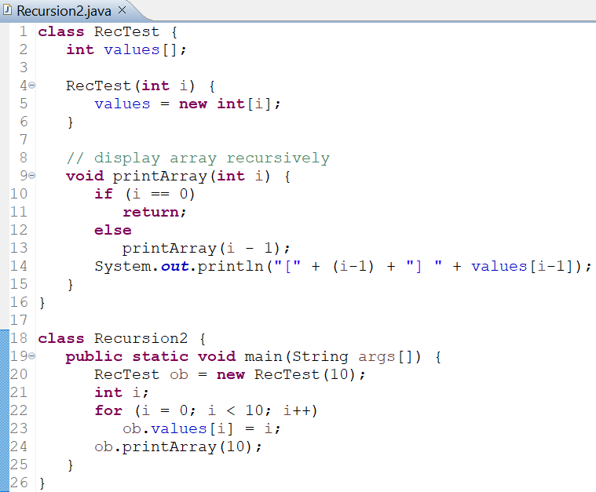
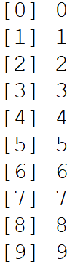
Recursive Array Printing
OUTPUT

Slide 31
Introducing Access Control

Slide 32
Introducing Access Control
In OOP, encapsulation links data with the code that manipulates it.
Encapsulation also provides another important attribute: Access Control.
Through encapsulation, we can control what parts of a program can access the members of a class.
By controlling access, we can prevent misuse.
For example, allowing access to data only through a well-defined set of methods, we can prevent the misuse of that data.
Thus, when correctly implemented, a class creates a “black box” which may be used, but the inner workings of which are not open to tampering.

Slide 33
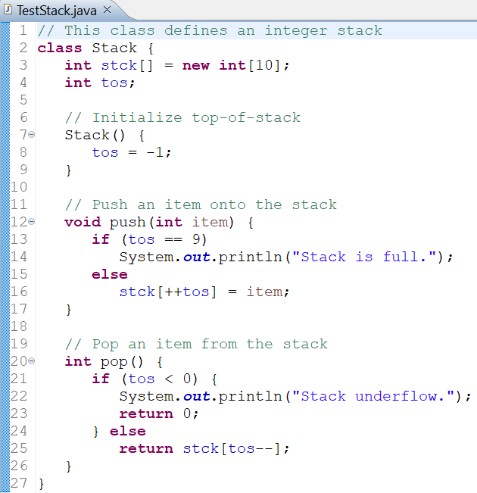
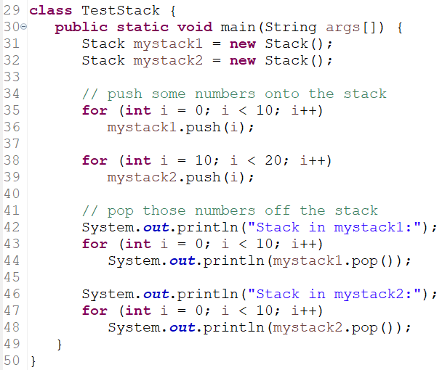
Introducing Access Control: Stack Example

Slide 34
Introducing Access Control: Stack Example
In the Stack class, while it is true that the methods push() and pop() do provide a controlled interface to the stack, this interface is not enforced.
That is, it is possible for another part of the program to bypass these methods and access the stack directly.
Of course, in the wrong hands, this could lead to trouble.

Slide 35
Access Modifiers
How a member can be accessed is determined by the access modifier attached to its declaration.
Java supplies a rich set of access modifiers.
Some aspects of access control are related mostly to inheritance or packages.
In this part, we examine access control that applies to a single class.
Java’s access modifiers are public, private, protected, and default.
protected applies to inheritance and will be discussed later.

Slide 36
Access Modifier: public & private
When a member of a class is modified by public, then that member can be accessed by any other code.
When a member of a class is specified as private, then that member can only be accessed by other members of its class.
The main() method has always been preceded by the public modifier because it is called by code that is outside the program—that is, by the Java run-time system.
When no access modifier is used, then by default the member of a class is public within its own package, but cannot be accessed outside of its package.

Slide 37
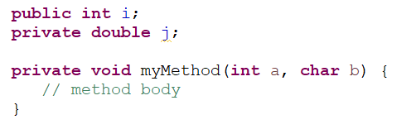
Access Modifier: public & private
For the sake of achieving encapsulation, usually we will want to restrict access to the data members of a class—allowing access only through methods.
Also, there will be times when we will want to define methods that are private to a class.
An access modifier must begin a member’s declaration statement.

Slide 38
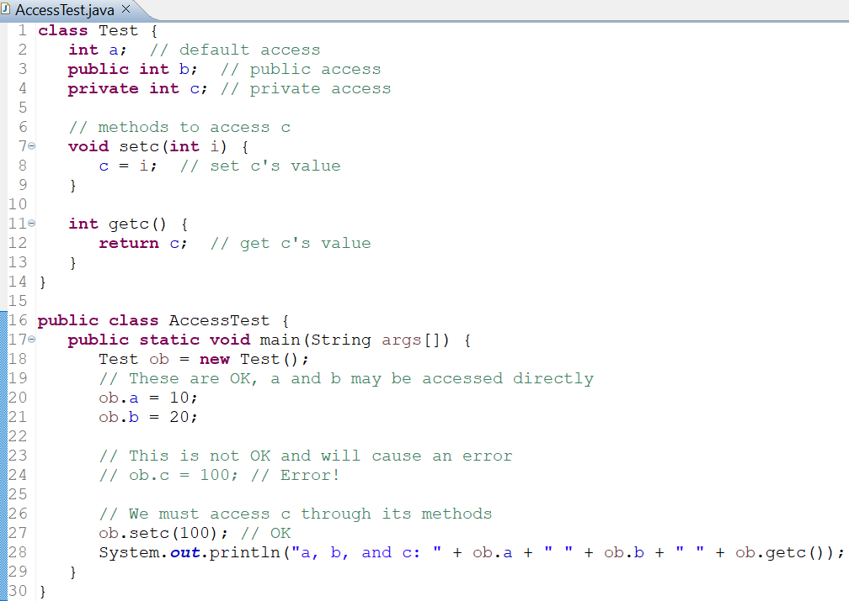
public & private: Example
Methods used to access private members are often called “getters and setters”, or “accessors and mutators”.

Slide 39
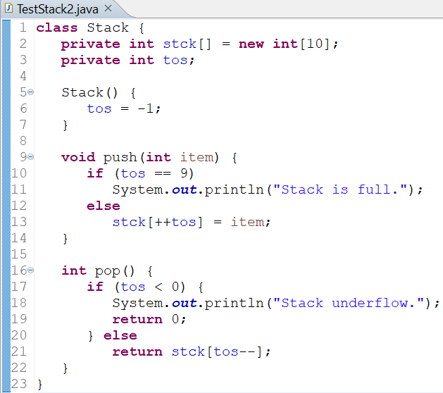
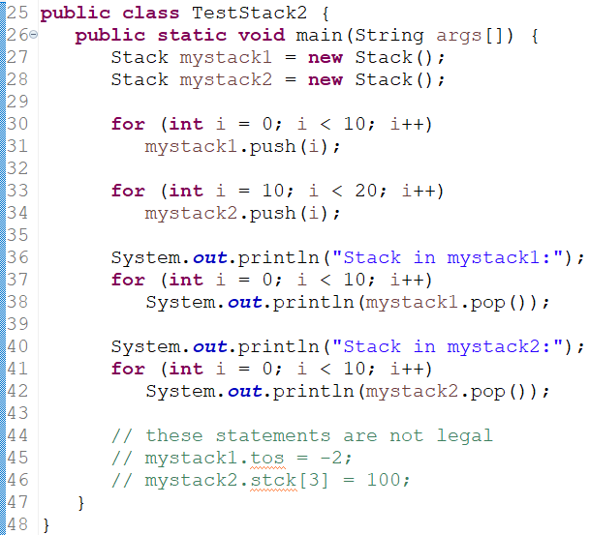
Stack Class with Access Modifiers

